Slide 1
AWS & Azure & Google: Cloud Comparison
Yichuan Zhang & Xiao Li & Yang Yuan

Slide 2
AWS & Azure & Google Cloud: Pricing

Slide 3
One of the great benefits of Azure, AWS and other cloud providers is their competitive pricing strategies.
They are all fighting to take workloads and migrate them to the cloud, in view of the recurring revenue they receive. This type of commoditization has forced a very open, online pricing model.
“You pay per minute, not per hour, which is how a cloud should work.” ---Google

Slide 4
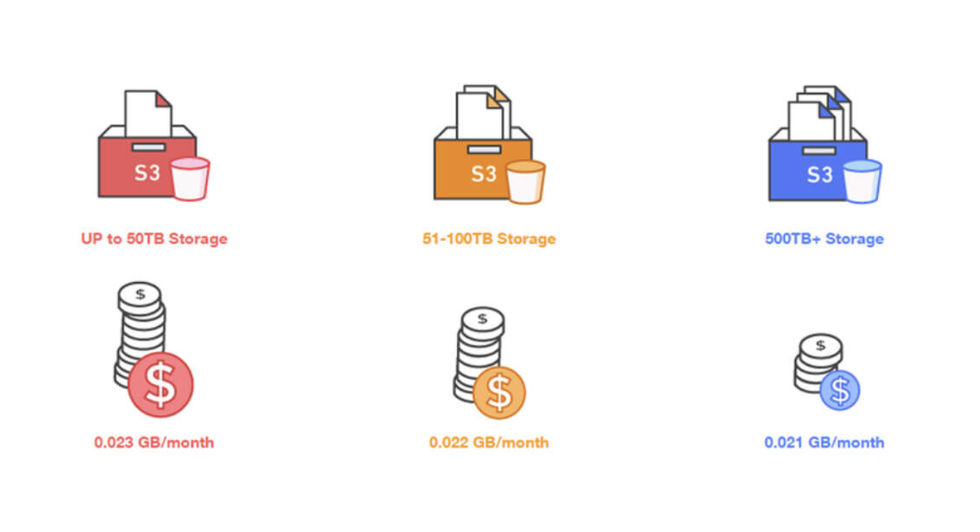
AWS Pricing
As can be seen below, their three-tier model, according to storage is very helpful if you just need to put some data in the cloud. Unfortunately, when it comes to storing 50TB - 500TB, the percentage price difference isn’t that large.

Slide 5
Similarly, there are many compelling elements to Microsoft Azure. Azure also has a breakdown of the various pricing situations, there pricing is more aggressive in certain section than amazon and google, owing to their desire to lead segments of the cloud. this includes elements such as moving apps into the cloud.
Azure Pricing

Slide 6
Google’s pricing model attempts to go head-to-head with its core competitors while emphasizing its desire to bill based on exact usage.
Google Cloud Pricing

Slide 7
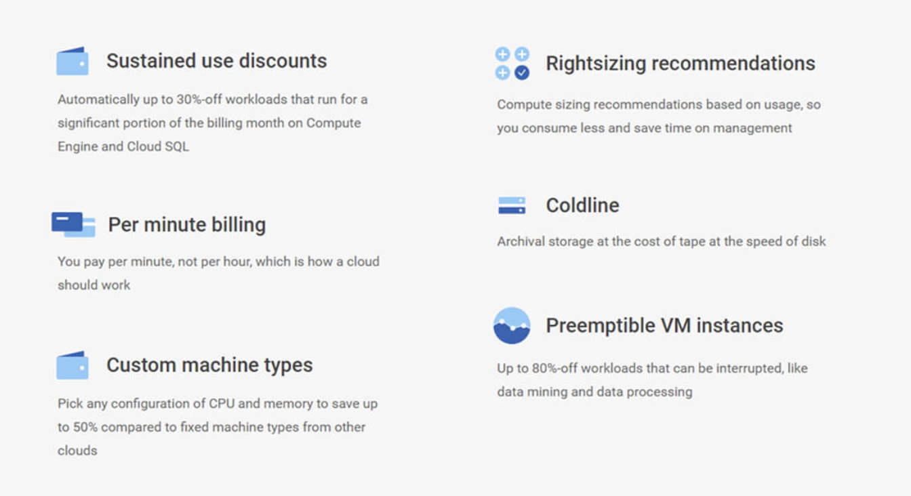
Here are some of their core pricing values:

Slide 8
AWS & Azure & Google Cloud: Features

Slide 9
All three of AWS, Azure and Google have their own way of categorizing the different elements.
Beyond comparing the pricing of these three cloud heavyweights, their features are also a very interesting factor in comparing.

Slide 10
Like the other two cloud providers, Amazon uses different codes and names to breakdown their cloud products. with that said, they fall into the following categories:
AWS Features:
Compute
Storage
Database
Migration
Networking & Content Delivery
Developer Tools
Management Tools
Security, Identity & Compliance
Analytics
Artificial Intelligence
Mobile Services
Application Services
Messaging
Business Productivity
Desktop & App Streaming
Software
Internet of Things
Game Development

Slide 11
When it comes to AWS solutions, there is equally a large degree of categorization. These solutions cover:
Websites
Backup and Recovery
Archiving
Disaster Recovery
DevOps
Big Data

Slide 12

Moving on to Microsoft Azure, they equally provide an enormous array of features, but they add value by providing certain capabilities based on the number of users.
Azure Features:
Another feature differentiator to Microsoft Azure is their degree of certification. In which they claim they have more ‘than any other cloud provider’.

Slide 13
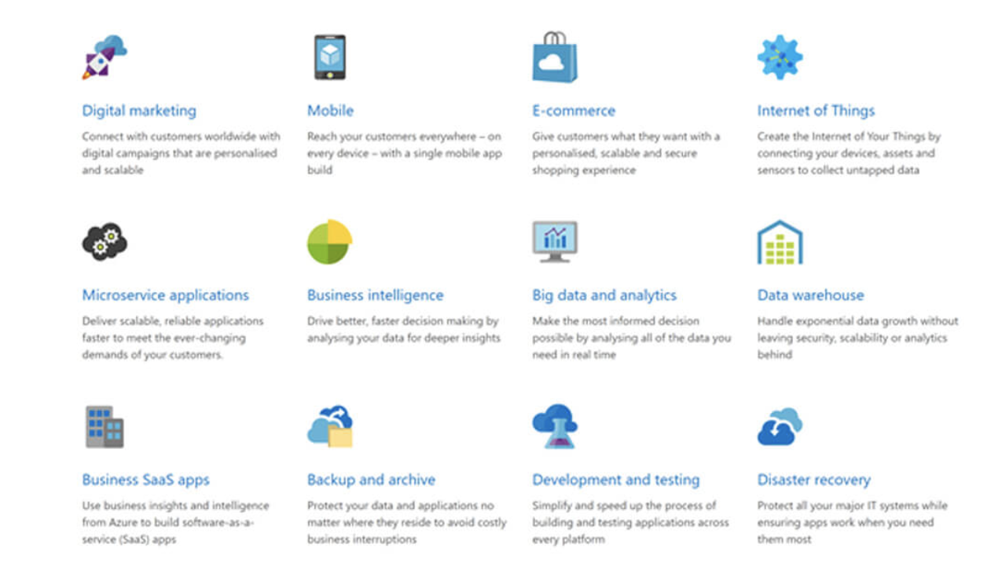
A bold statement, but with a similar features range to AWS [see below] - they believed this security can persuade organizations to place their trust in Microsoft.

Slide 14
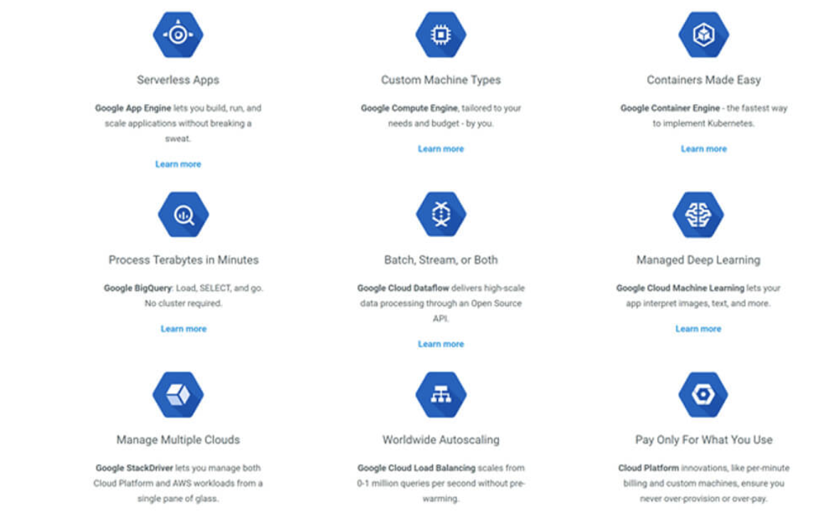
GCP, which while not necessarily the most historical cloud provider, is throwing its self into enterprise computing.
Google Cloud Features:
Three key points behind their solutions: 1. Future-proof infrastructure 2. Seriously powerful data & analytics 3. Serverless, just code

Slide 15
AWS & Azure & Google Cloud: Implementations

Slide 16
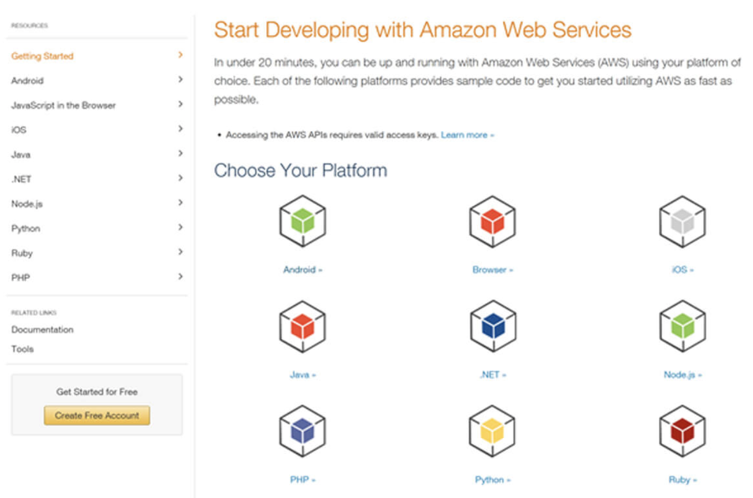
AWS Implementation:
AWS provide a nice and easy page to start using their services.
You can see that they break it down by platform you wish to work on, so whether you are making an iOS app, or writing in PHP, they provide some sample code to begin the integration.

Slide 17
Azure Implementation:
Unleashing the benefits of Azure is an equally easy journey.
The nice thing about Microsoft's process is that they consider things for the developer and operations, both of which come with in-depth start guides.
More importantly, they are an easy forward to the relevant department if you need to check suitability.

Slide 18

We understand that the topic of Azure vs AWS in sometimes for contentious than the three-way battle, so this infographic from InApp may shed a light:

Slide 19
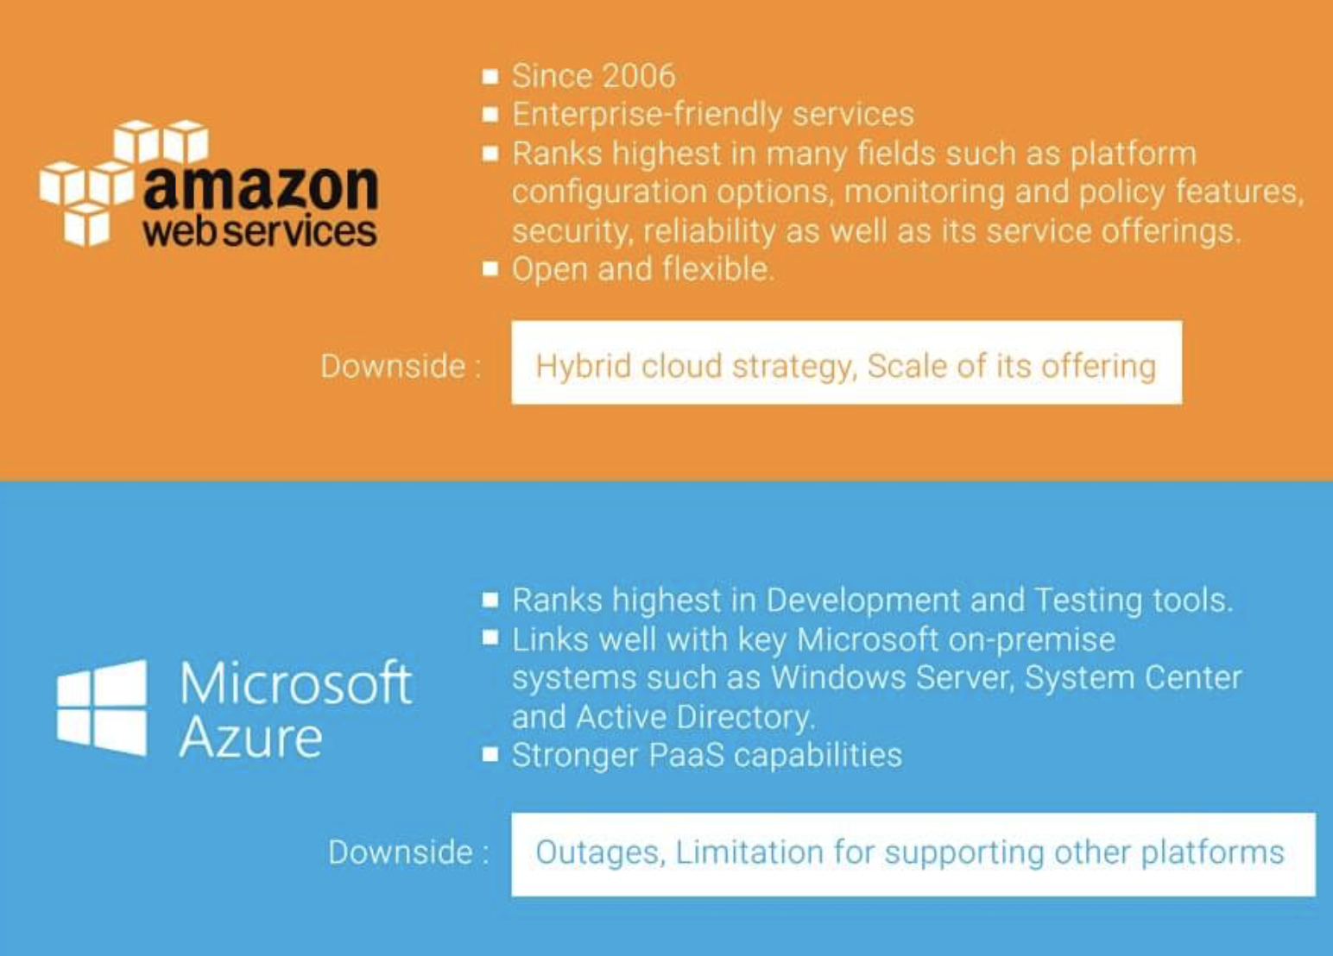

Slide 20
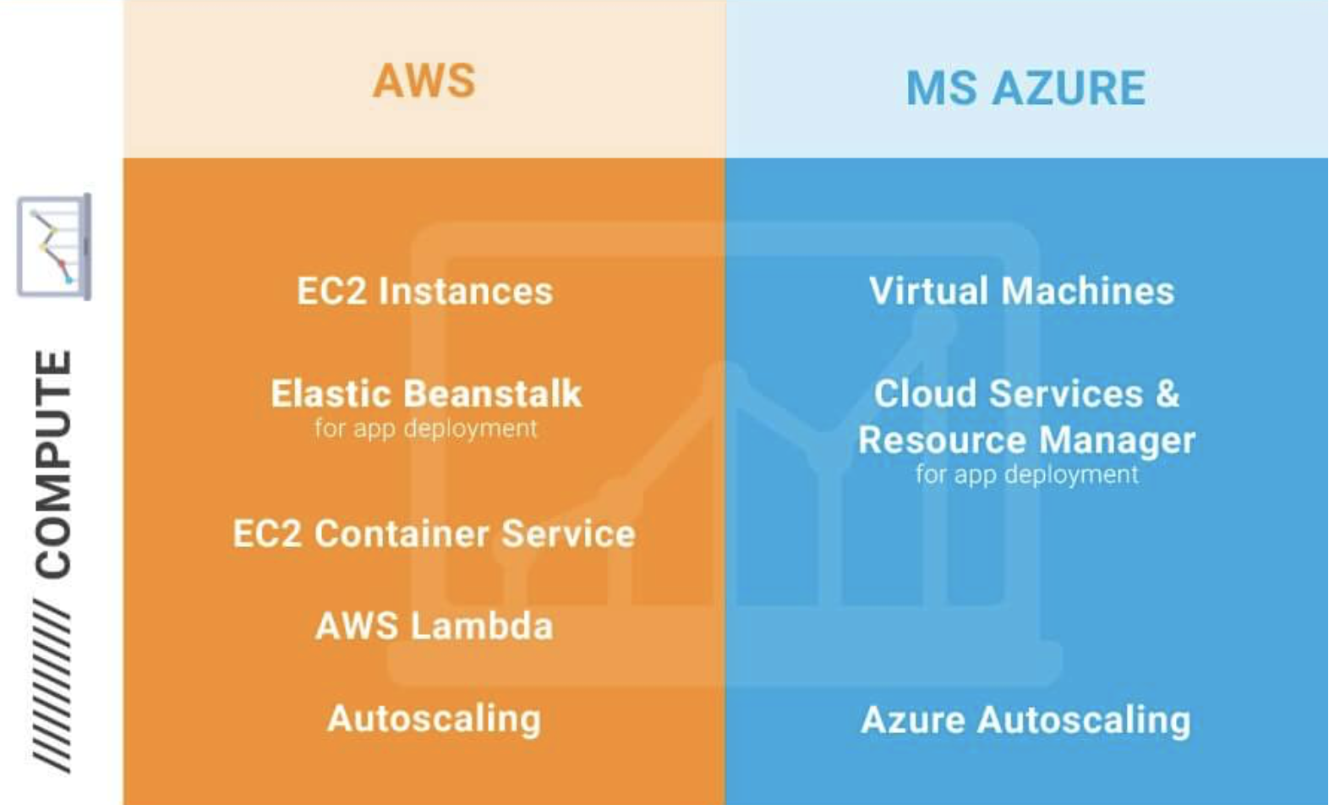

Slide 21
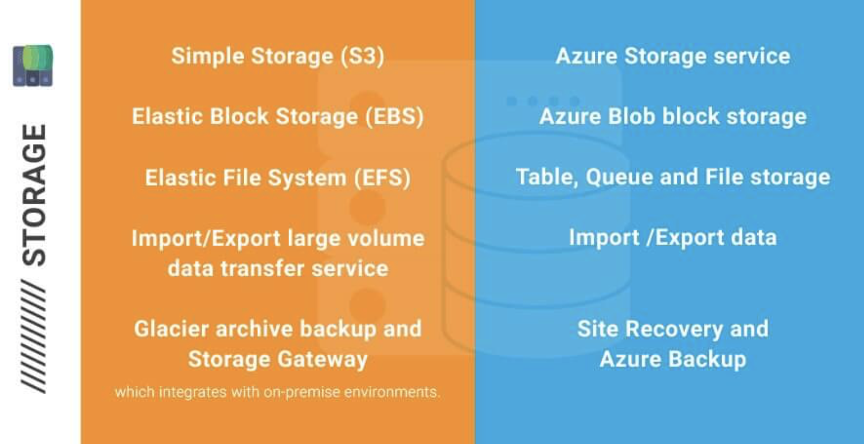

Slide 22
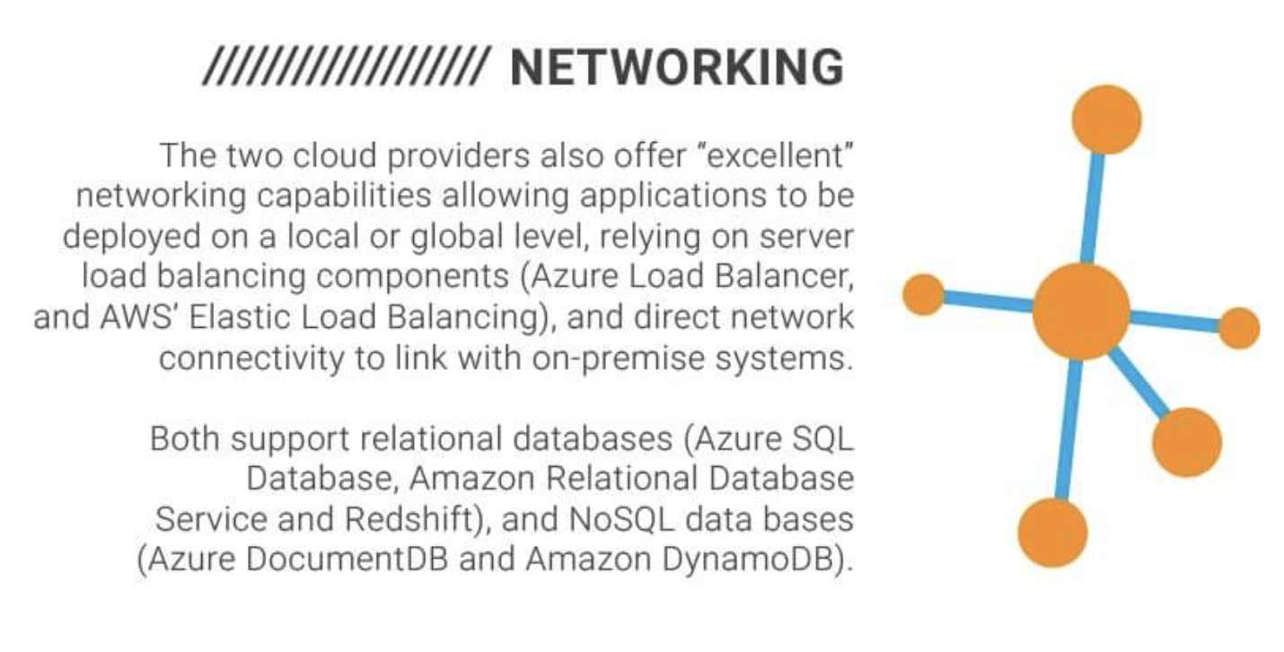

Slide 23
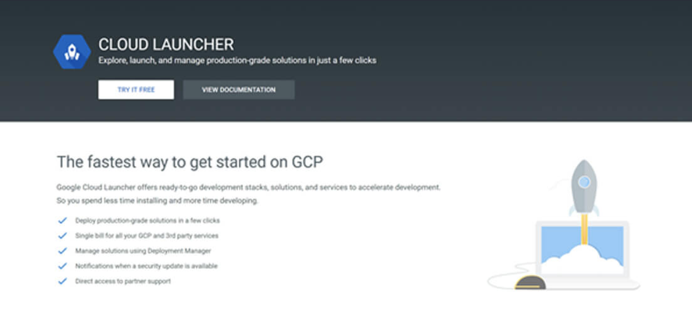
Google Cloud Implementation:
Lastly, we have the process of starting with Google - named ‘Cloud Launcher’. They equally provide some starting documentation and list some useful benefits, see below.

Slide 24


Slide 25
Thank you for watching!

